Slide 1

Senior Class Agenda
Clements High School Counseling Team

Slide 2
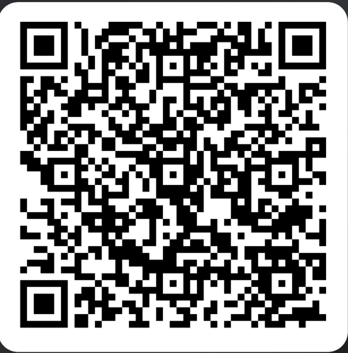
Scan the QR Code below (or type the URL) to check in!
WelcomeClass of 2025!
https://tinyurl.com/2ja58pz7
Clements High School Counseling Team

Slide 3

The Year's Agenda
  01
  04
Requesting Transcripts & Letters of Recommendation
Graduation Requirements
  02
  05
Schoolinks
  CCRA Mrs. Crowder
  03
  06
College Applications
811 See Something, Say Something

Slide 4


  01
Graduation Requirements
Am I on the right track?
Check your transcript and verify it has everything you need for graduation.
Passed 5 End of Course Exams
Do you have a declared Endorsement?
If you see any problems, please contact your counselor ASAP!!!
4 English credits
4 Math credits
4 Science credits
3 Social Studies Credits (4 recommended)
2 Foreign Language credits (same area)
1 Physical Education credit
1 Fine Art credit
.5 Speech credit
.5 Health credit
5 Elective credits (in Pathway)
GRADUATION REQUIREMENTS

Slide 5



  02
Schoolinks
It’s all about YOU!!!
Schoolinks Activity: Goal Setting
*Log in to Schoolinks
*Activities
*My Goals
Choose your Future Path
Choose your Career Goal
Select up to 3 Colleges
Choose your Major
*Create one Smart Goal that
combines all of the goals you just
created.

Slide 6



  03
College Applications
Applying to College
Apply Texas
Common Application
Direct to Institution

Slide 7


Slide 8

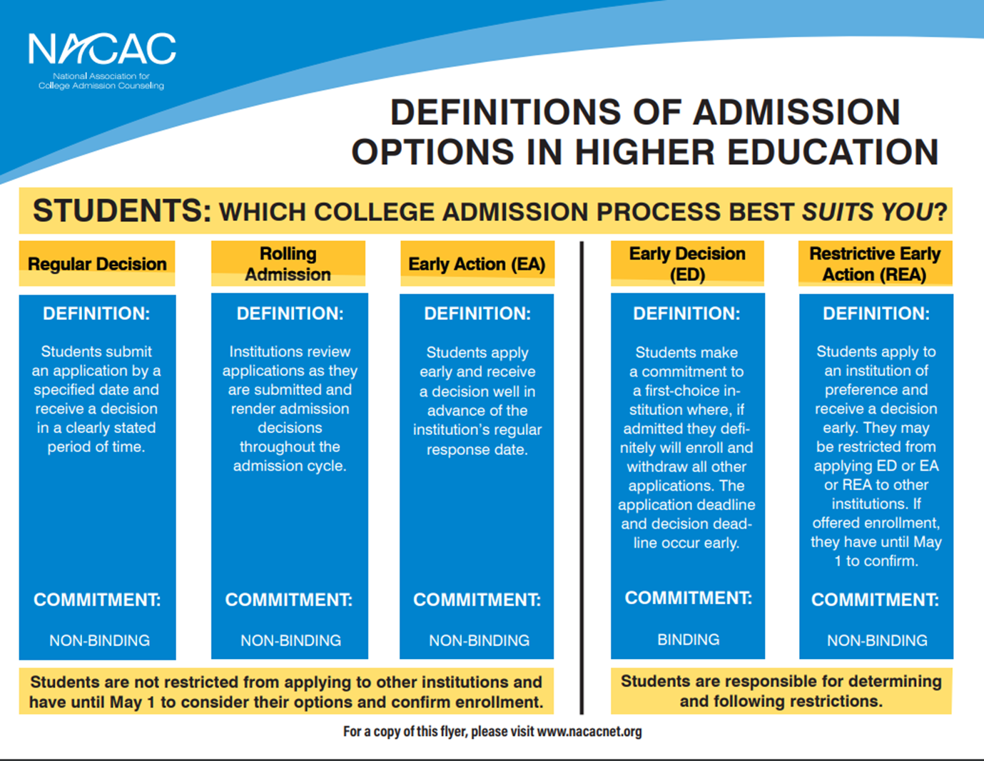
  03
Admission Types
College Applications

Slide 9
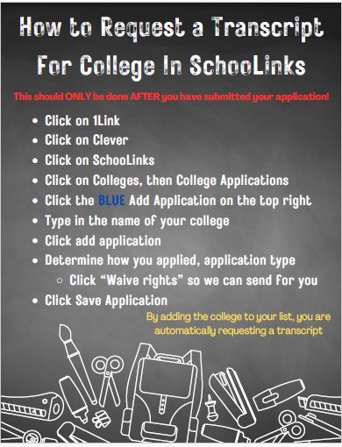
  04
Requesting Official Transcripts
Requesting Transcripts

Slide 10
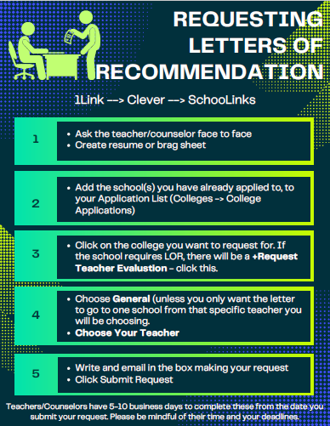
  04
Requesting Letters of Recommendation
Requesting Letters of Recommendation
https://www.youtube.com/watch?v=jeSLhLs4BUY

Slide 11
  04
After requesting your letters of recommendation
Additional steps to requesting letters of recommendation...
Counselors do NOT receive alerts from Schoolinks. Please use the steps below to request letters of recommendation from your counselor:
Complete the Letter of Recommendation Jot Form
We will make an appointment to see you if necessary!
Please give your counselor/teacher a 3- week notice minimum, when requesting a letter.

Slide 12

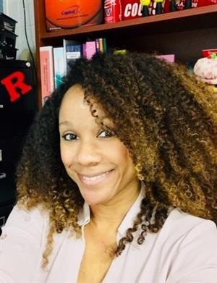
  05
CCRA
Mrs. Crowder
College Applications
FAFSA
Scholarships
FERPA
ACT vs. SAT
Test Optional vs. Test Blind

Slide 13



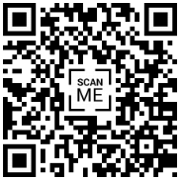
  06
  988
See Something Say Something
https://www.youtube.com/watch?v=sQnHUzfYGiE

Slide 14

Thank you!

